Slide 1

Design and evaluation of a Deep Learning approach to quantify immune cell infiltrates in volumetric autofluorescence image data
Dobrovolskii Sergei
Master Thesis
Superviser: Dr. Sebastian Schürmann

Slide 2
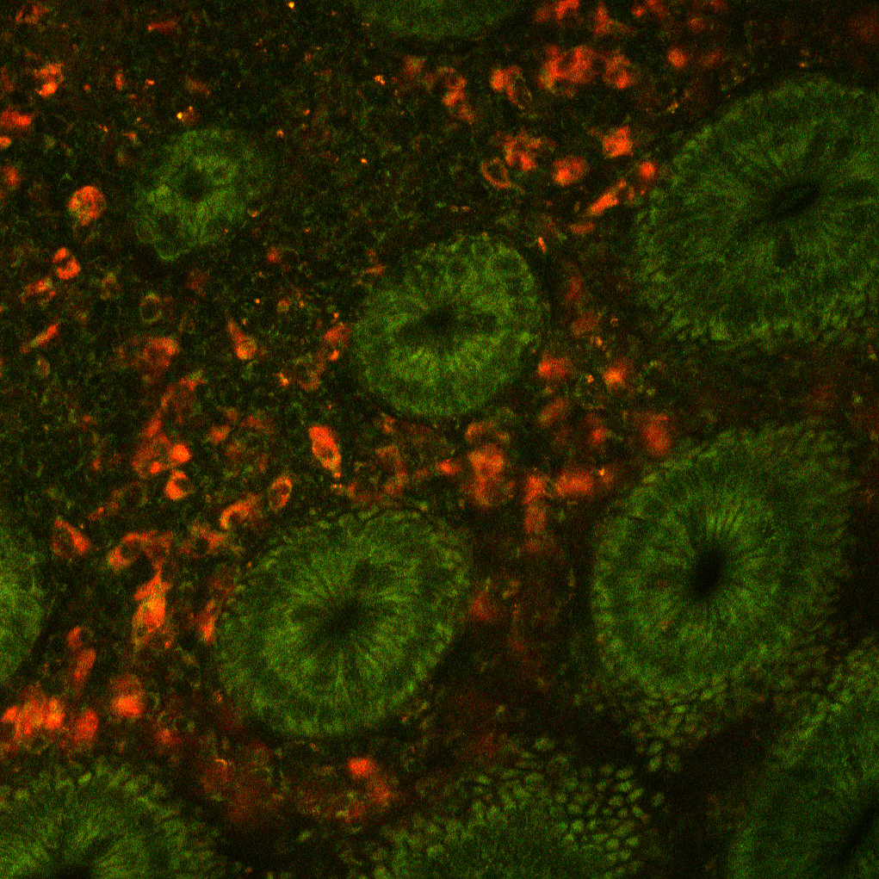
Outline
01
Motivation
02
Cell Simulator
03
Neural Network
04
Quantification performance
05
Conclusion

Slide 3
Motivation Quantification of immune cells in stacks

Slide 4
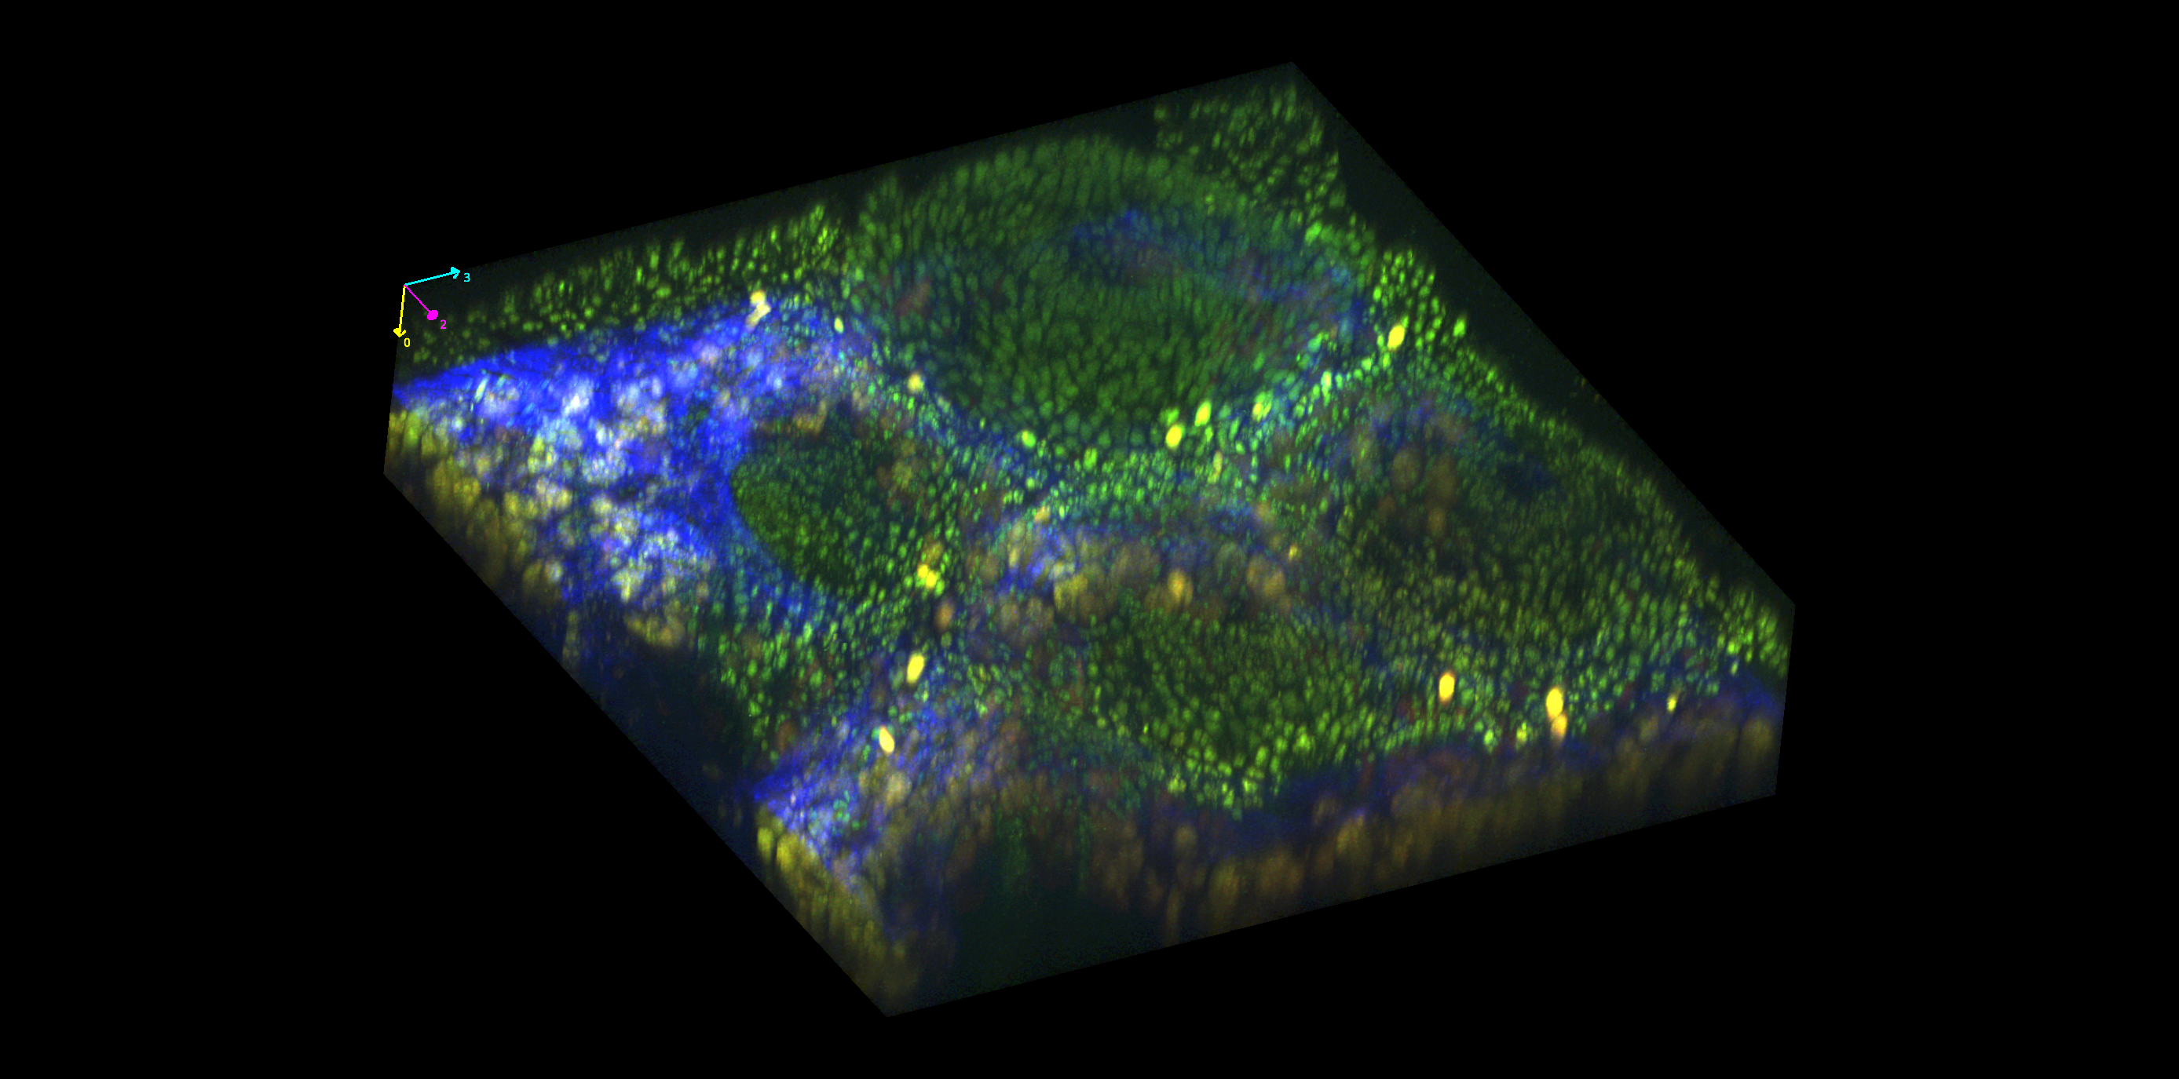
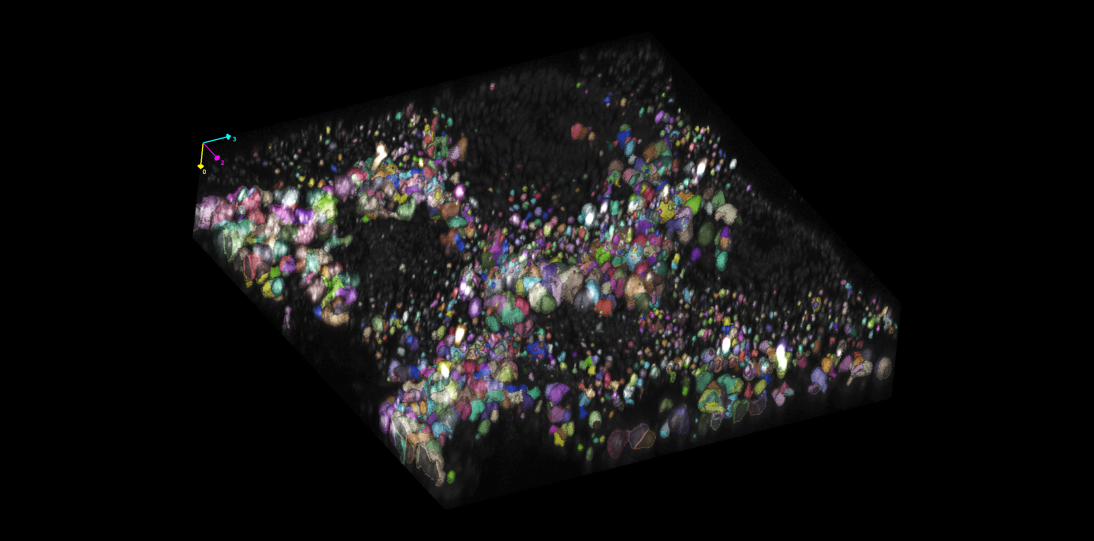
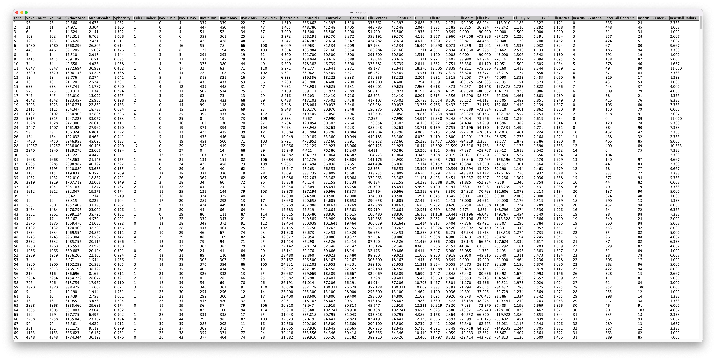
Analysis sequence
Common analysis sequence for cell count and classification
1.
2.
3.
3D stack of human colon tissue, acquired with MPM
Cell segmentation and labeling
Statistical analysis

Slide 5
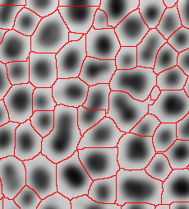
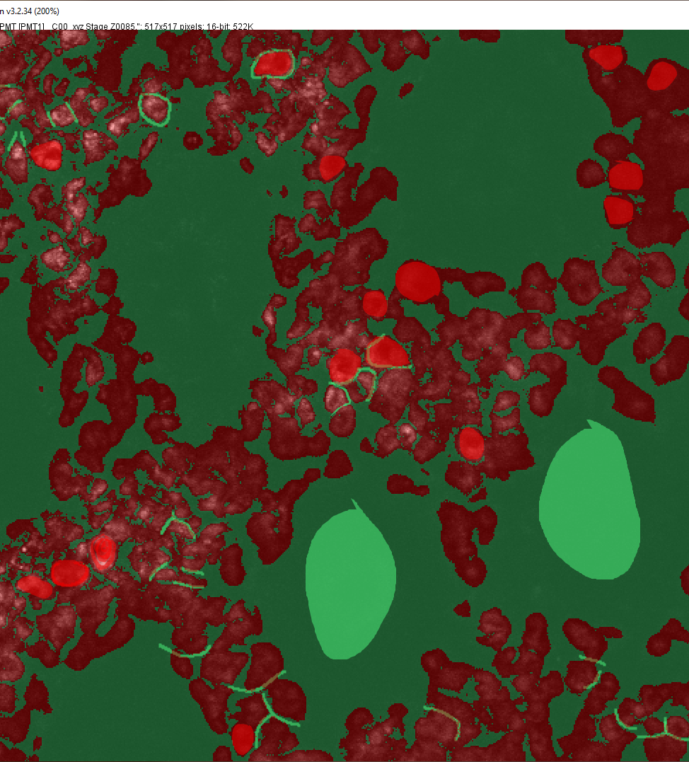
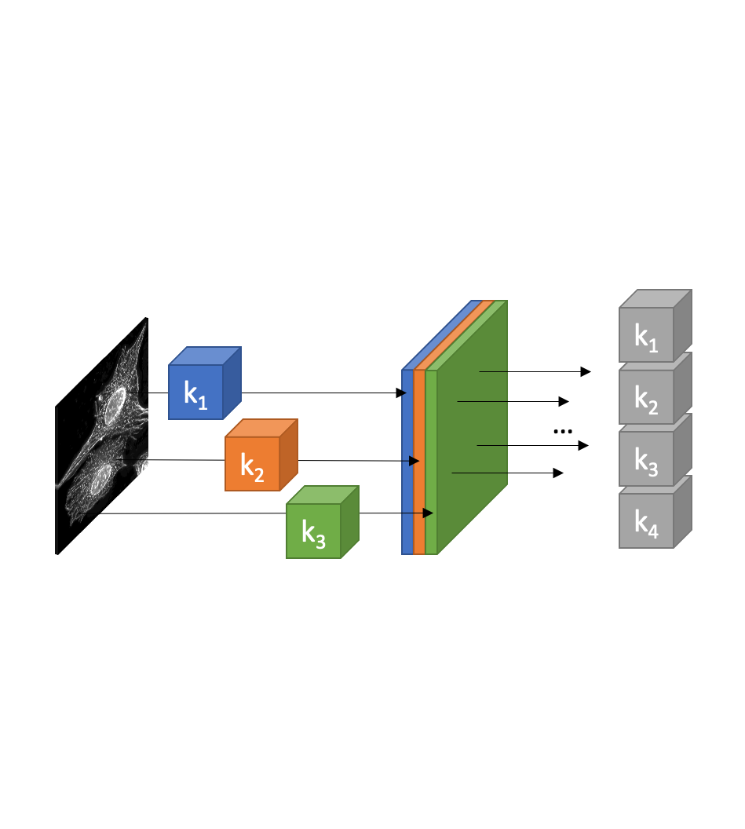
Image analysis
Three main image analysis approaches
Classical algorithms:
Threshold, Watershed, region growing, filtering…
Classical Machine Learning algorithms: Random Forest: Ilastik, Weka ImageJ plugin
Modern Machine Learning (Deep Learning): U-net, LinkNet, Mask-RCNN, YOLO

Slide 6
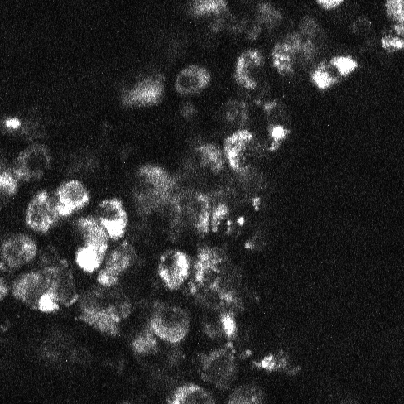

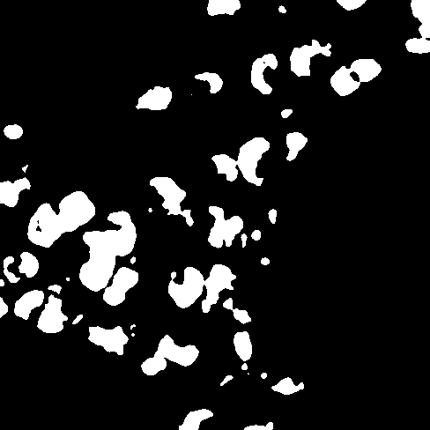


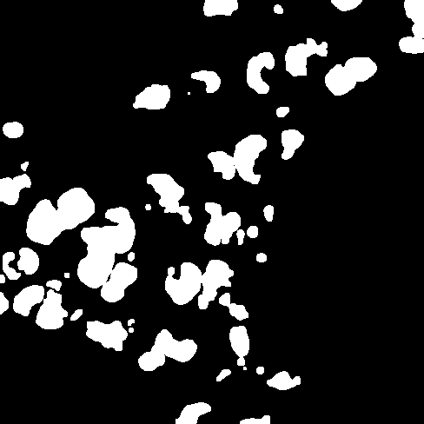

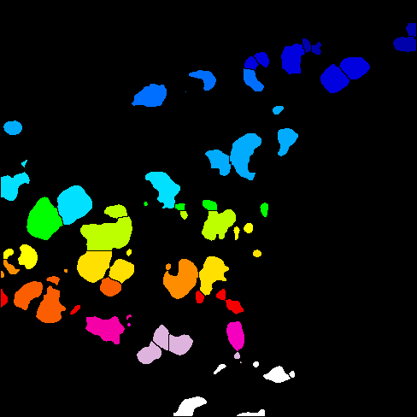
Image analysis
Common sequence to analyze and classify cells with classical algorithms
Common operations for cell segmentation:
Gaussian blur
Threshold
Fill holes
Dilate
Erode
Watershed
Labeling
Cell-wise analysis
Common features for cell classification:
Size
Volume
Perimeter
Intensity
Sphericity
Shape
Eccentricity
Texture
0.Raw
1.Blur
2.Threshold
3.Fill holes
4.Erode
5.Dilate
6.Watershed
7.Label

Slide 7
Image analysis
Why classical algorithms are not compatible with experimental data
Why it does not work?
Images are volumetric
Illumination inhomogeneties
Signal to noise (autofluorescence)
Acquisition artifacts (PSF, scattering, attenuation)
High cell density
High image variation
FAD fluorescence

Slide 8
Machine Learning in image analysis
What is Machine Learning?
Question
Answer
Data
ML algorithm
Output
Exploitation phase
Data
ML algorithm
Output
Training phase

Slide 9
Machine Learning in image analysis
Classical Machine Learning vs. Deep Learning
Classical Machine Learning approaches
Acquisition
Preprocessing
Feature Extraction
Classification
Class
ML algorithm
Deep Learning approaches
Acquisition
Preprocessing
Feature Extraction
Classification
Class
DL algorithm

Slide 10
Aims
Aims of this project
Aims of this Master Thesis Project:
Develop a computer vision system that could analyze volumetric label free images of human colon tissue. This system must be able to localize, classify and count immune cells.
Develop a simulation framework that could imitate real volumetric label free images of human colon tissue for computer vision system training and evaluation.

Slide 11
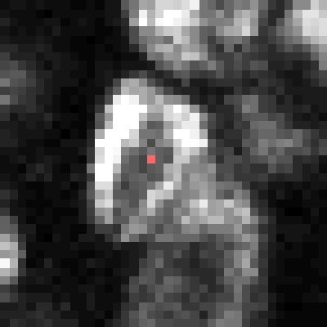
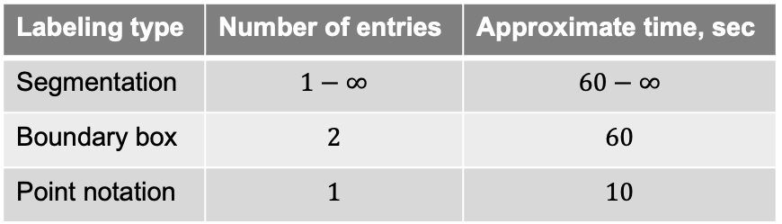
Machine Learning in image analysis
Motivation behind labeling type
Ways to label data for Deep Learning algorithm:
Segmentation – whole cell volume is labeled
Boundary box – 2 vertices are labeled (6 coordinates)
Point notation – 1 vertex is labeled (3 coordinates)
Common DL dataset size is bigger than 10 images, hence 10 * 500 cells = 5000 labeled cells.
1.
2.
3.
Table 1: comparison table between labeling approaches
Labeling type | Number of entries | Approximate time, sec
Segmentation | $$1−∞$$ | $$60−∞$$
Boundary box | $$2$$ | $$60$$
Point notation | $$1$$ | $$10$$

Slide 12
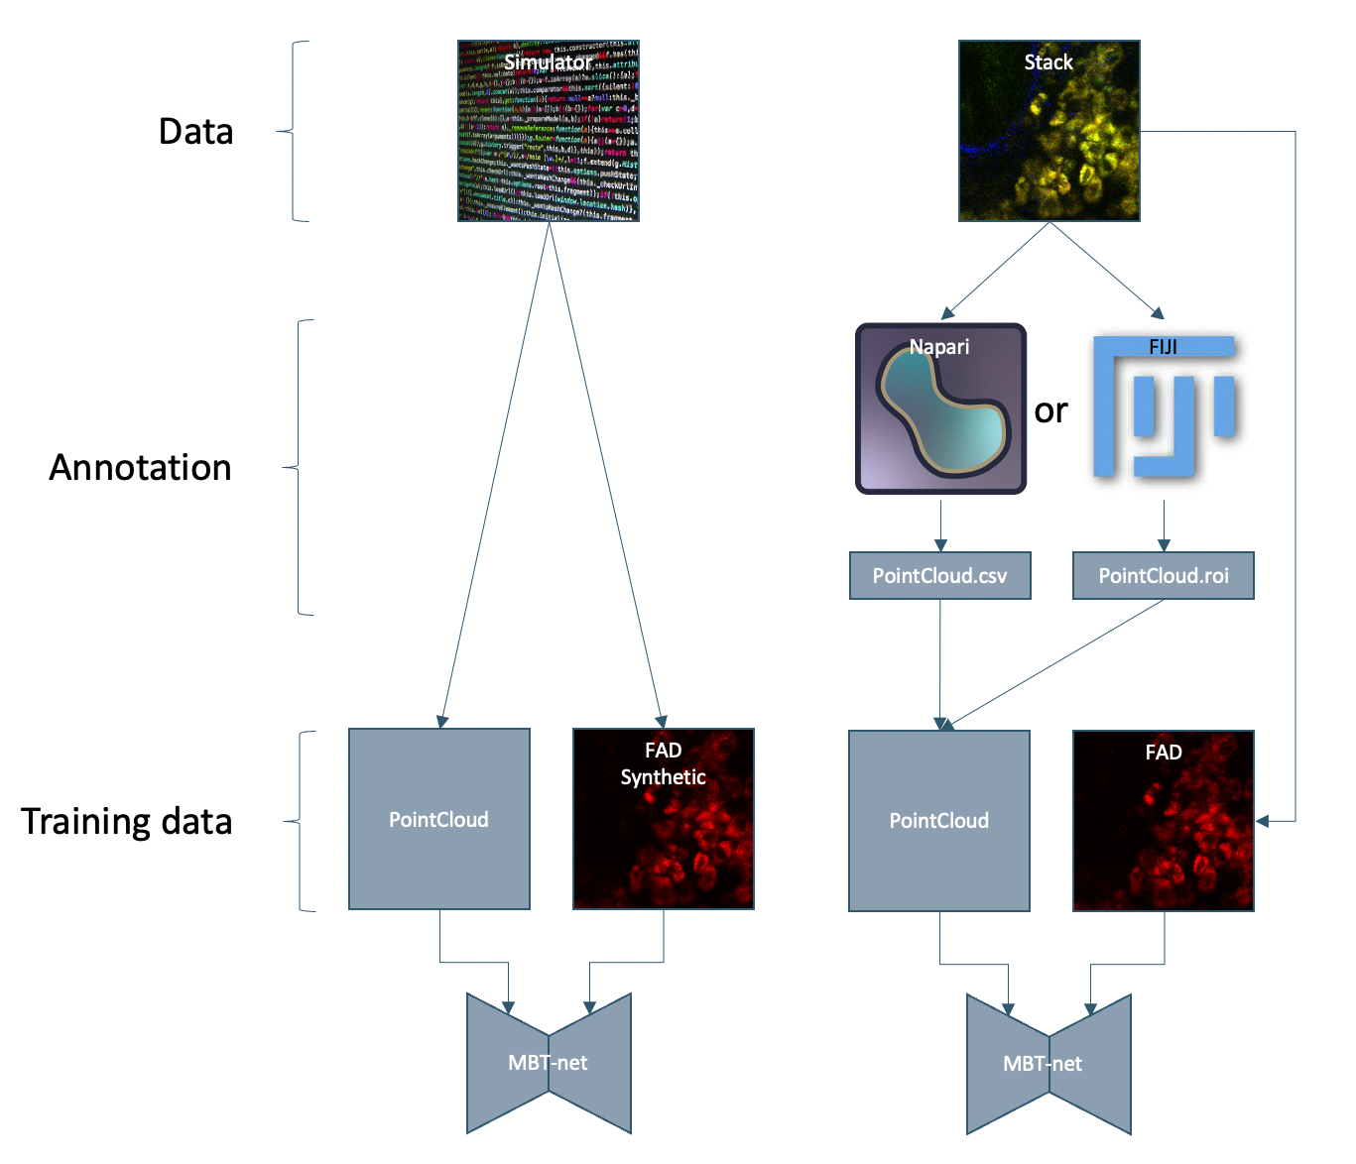
Machine Learning in image analysis
Neural Network Training
Current project state
Future work
Current project state
Cell simulator is developed and used to generate training data for MBT-net to evaluate its performance
MBT-net is designed, and trained on artificial data as proof of concept
Future work
Acquisition of image stacks with researched parameters
Real stacks manual annotation
Training MBT-net on real stacks
Using MBT-net for cell quantification and classification

Slide 13
Results: Cell Simulator

Slide 14
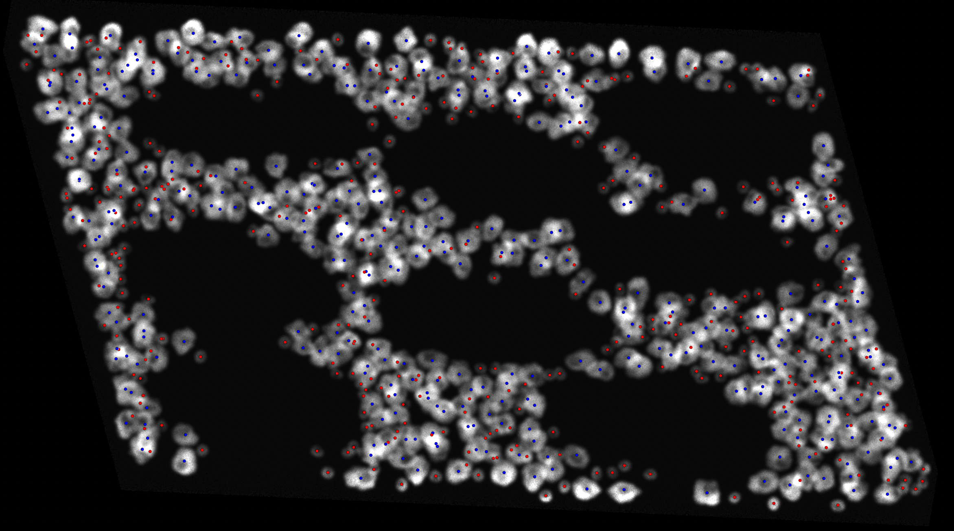
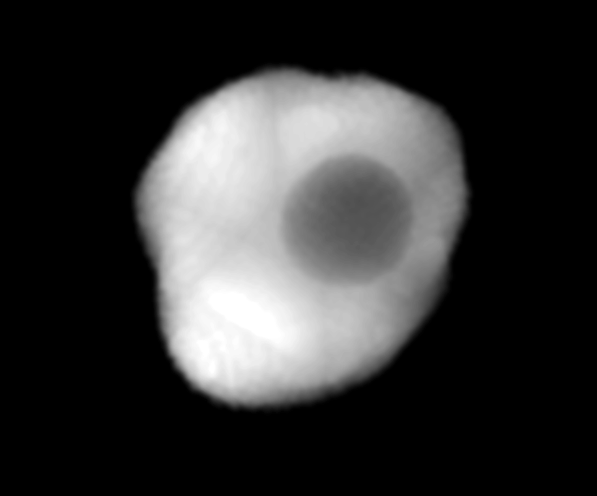
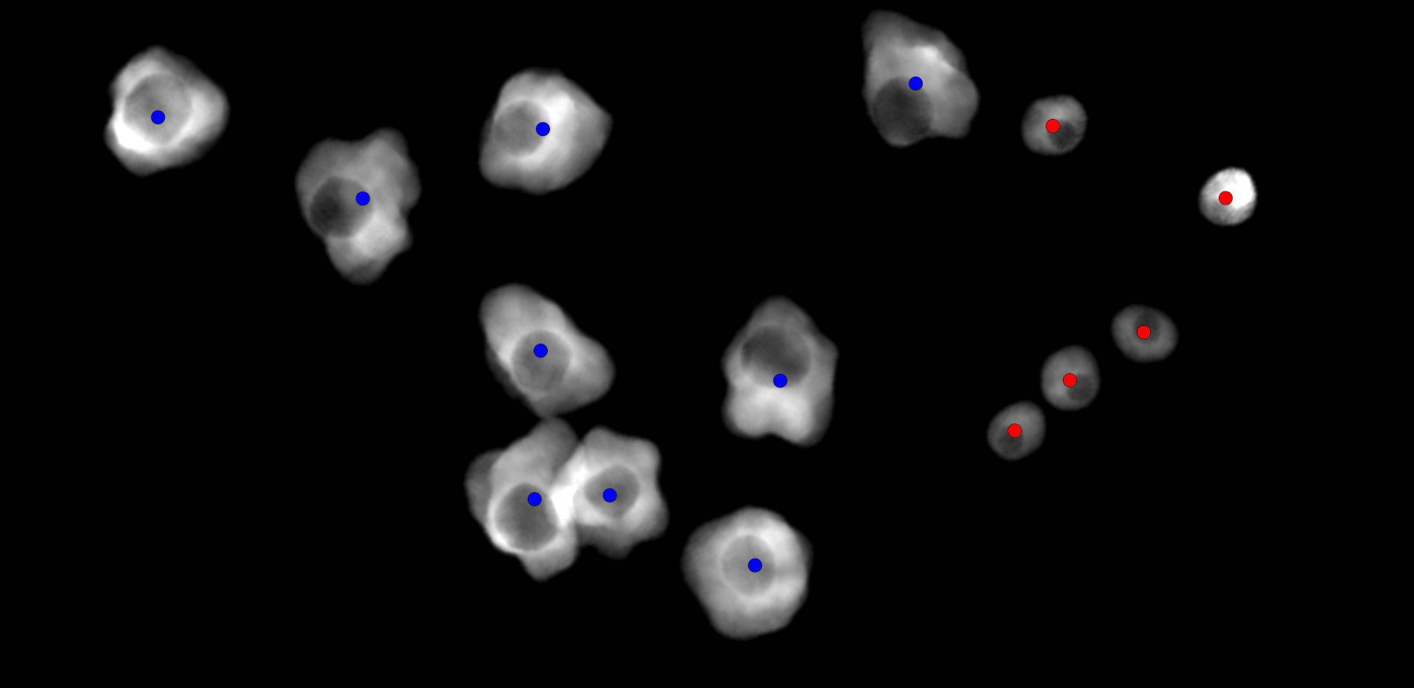
Cell Simulator
A framework for dataset simulation
Cell Simulator
A software framework for simulation of MPM stacks in FAD channel of immune cells in colon tissue.
Simulates different cell types with variable parameters (size, shape)
Simulates volumetric stacks
Simulates crypts

Slide 15
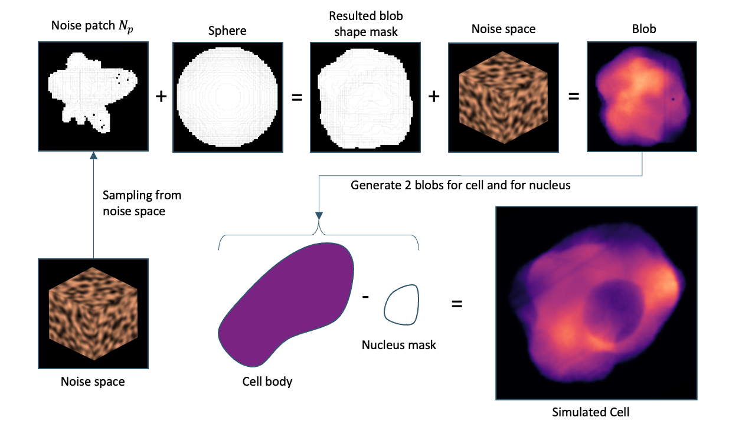
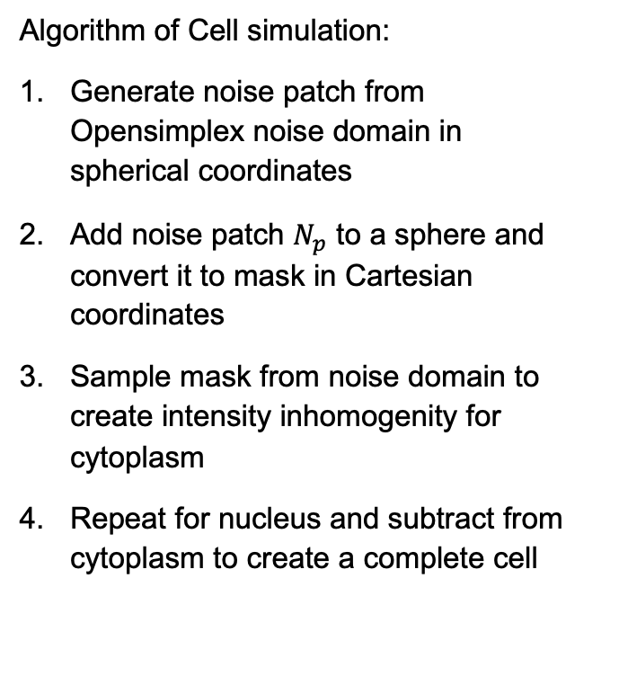
Cell Simulator
Simulation of immune cell
Algorithm of Cell simulation:
Generate noise patch from Opensimplex noise domain in spherical coordinates
Add noise patch $N_{p}$ to a sphere and convert it to mask in Cartesian coordinates
Sample mask from noise domain to create intensity inhomogenity for cytoplasm
Repeat for nucleus and subtract from cytoplasm to create a complete cell

Slide 16
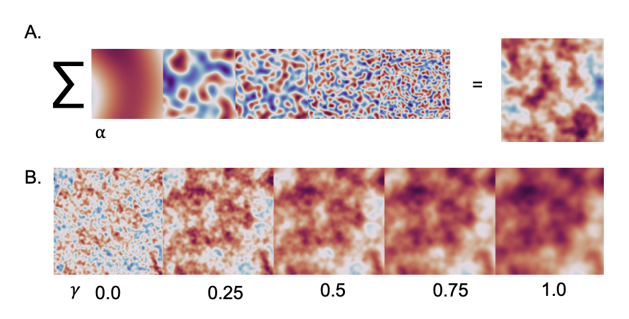
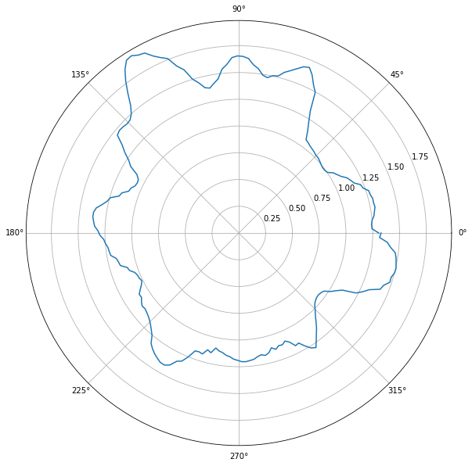
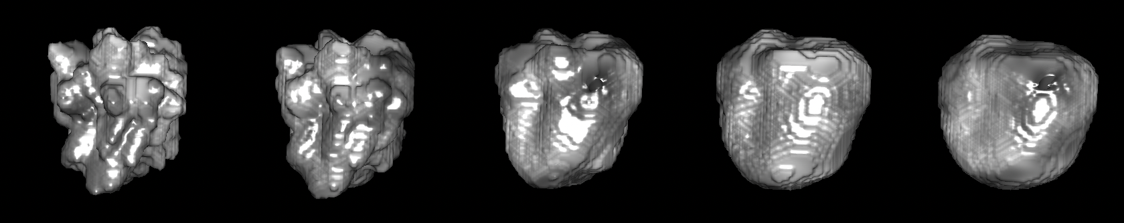
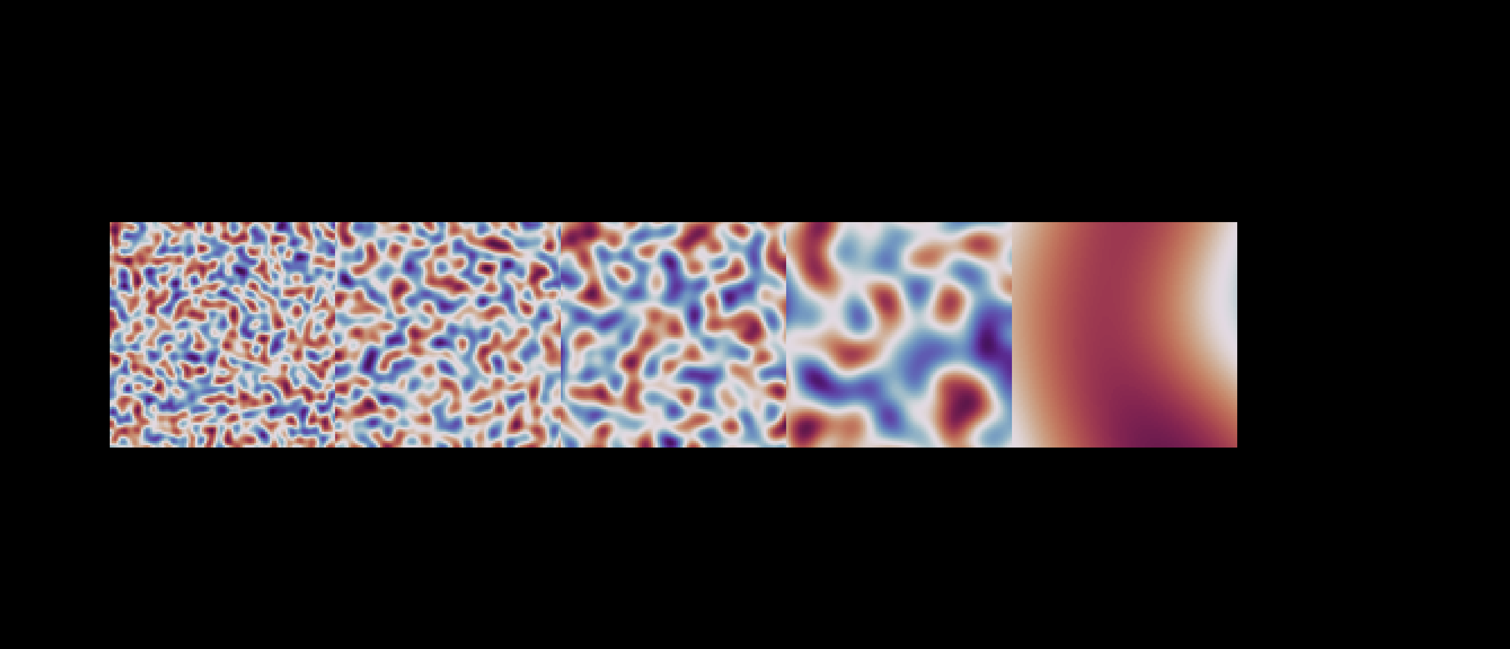

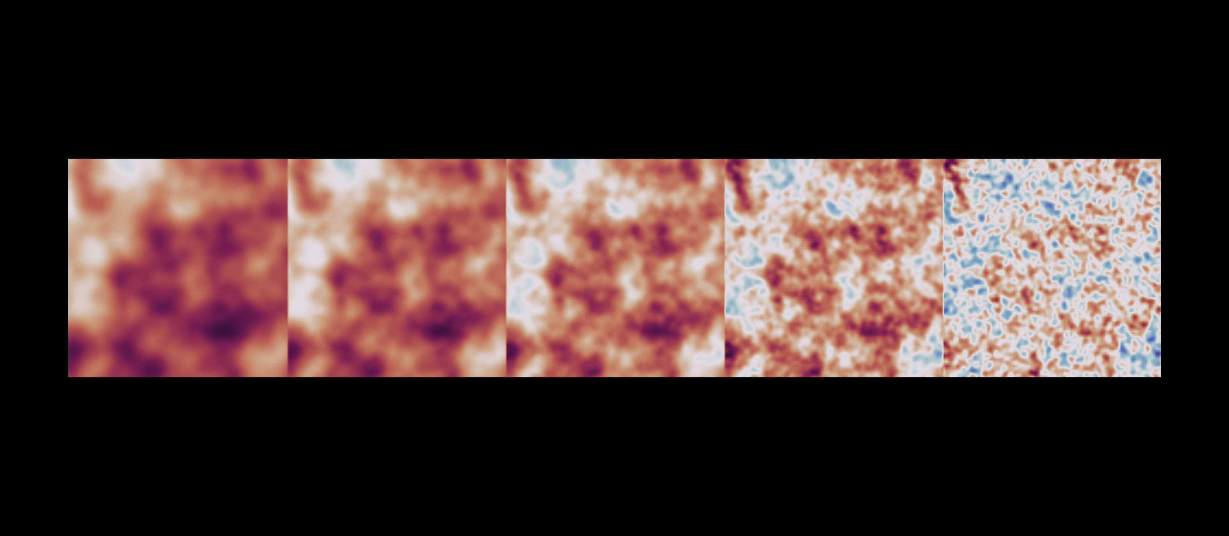
Cell Simulator
Parameters to compute cell shape from opensimplex noise domain
By changing parameters, different cell types could be generated
A.
∑
=
⍺
B.
𝛾
0.0
0.25
0.5
0.75
1.0

Slide 17
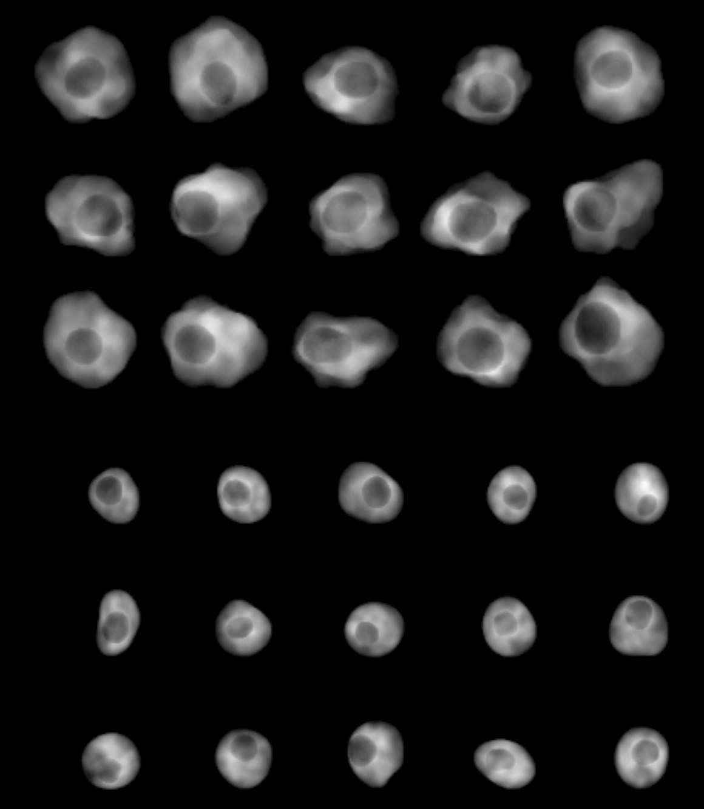
Cell simulator
Simulation results of two cell types
Simulated macrophages
Table 2: spreadsheet of simulation parameters
Cell type | Cytoplasm size, µm | Nucleus size, µm | 𝛾, nucleus shape | c, nucleus shape | 𝛾, cytoplasm shape | c, cytoplasm shape
Macrophage | 15 | 6 | 1.5 | 2.0 | 0.5 | 1.5
T-Cell | 9 | 4 | 1.5 | 2.0 | 1.5 | 2.0
Simulated T-Cells

Slide 18
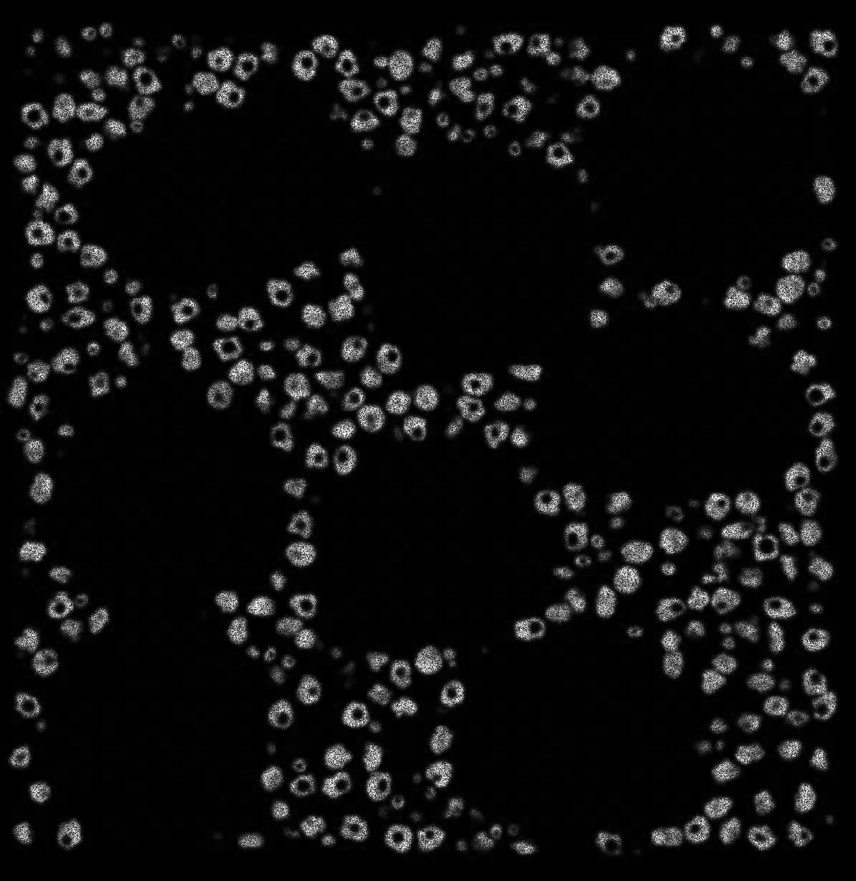
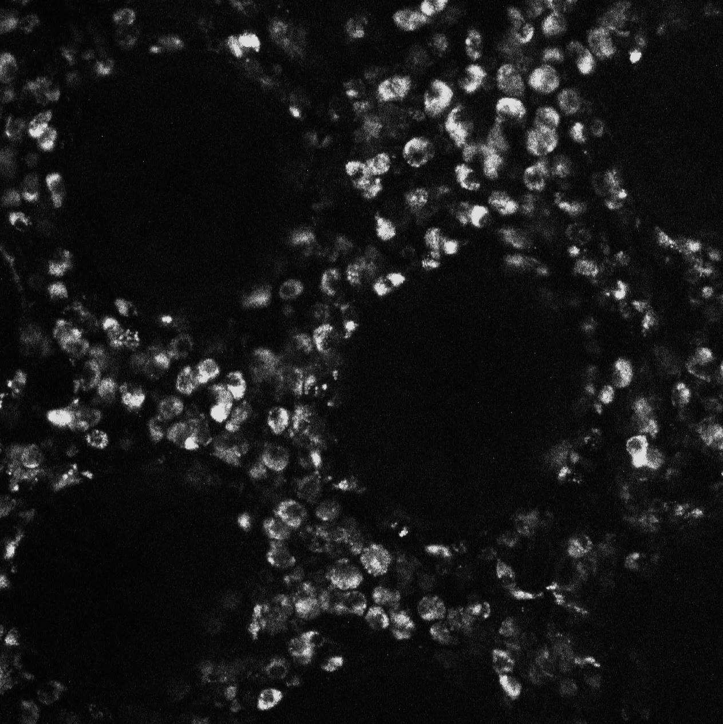

Cell Simulator
Simulation results
Simulated
Real
Simulated volume view
50 µm
Macrophage
T-cell
100 µm
100 µm

Slide 19
Results: Neural Network

Slide 20
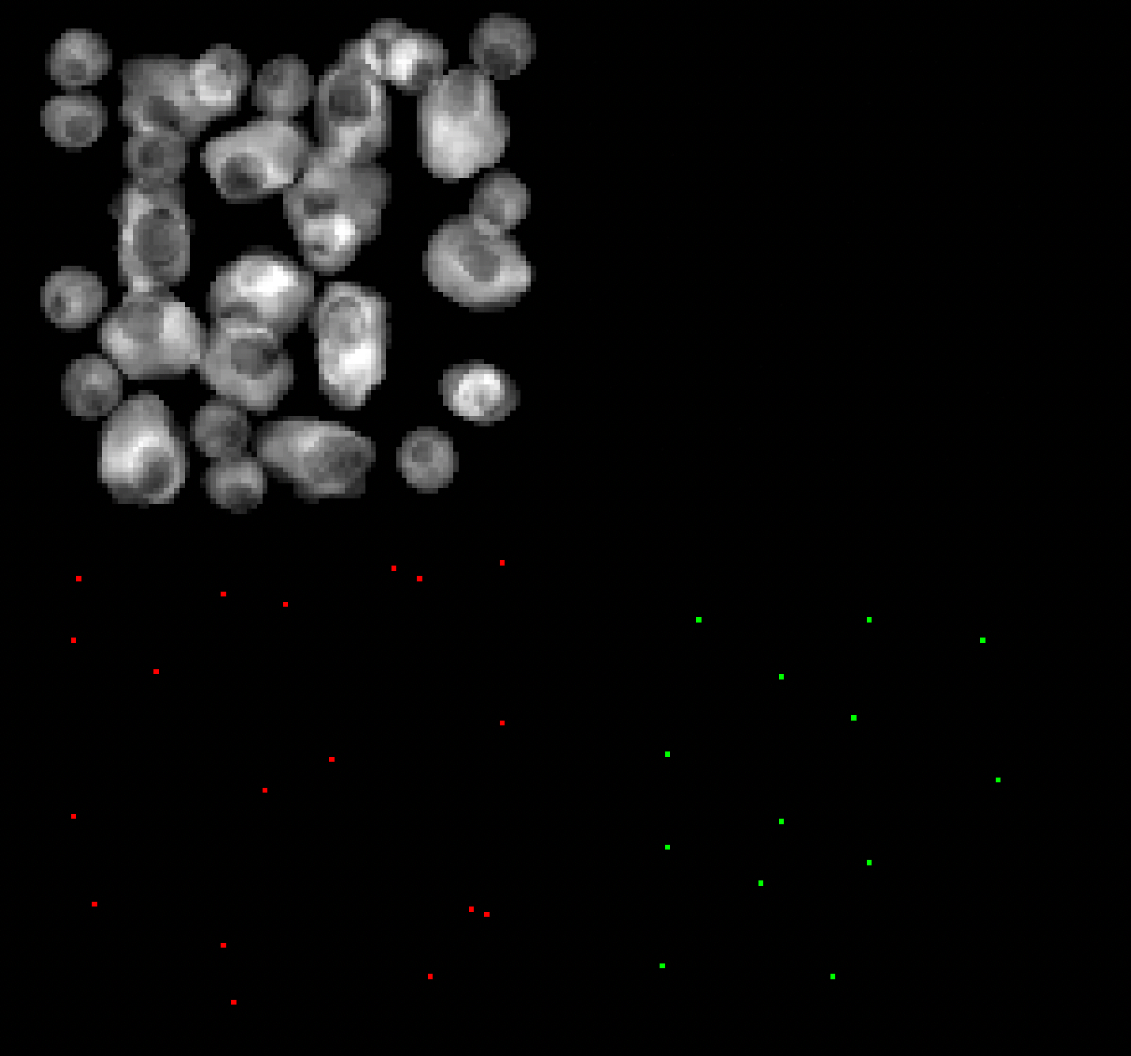
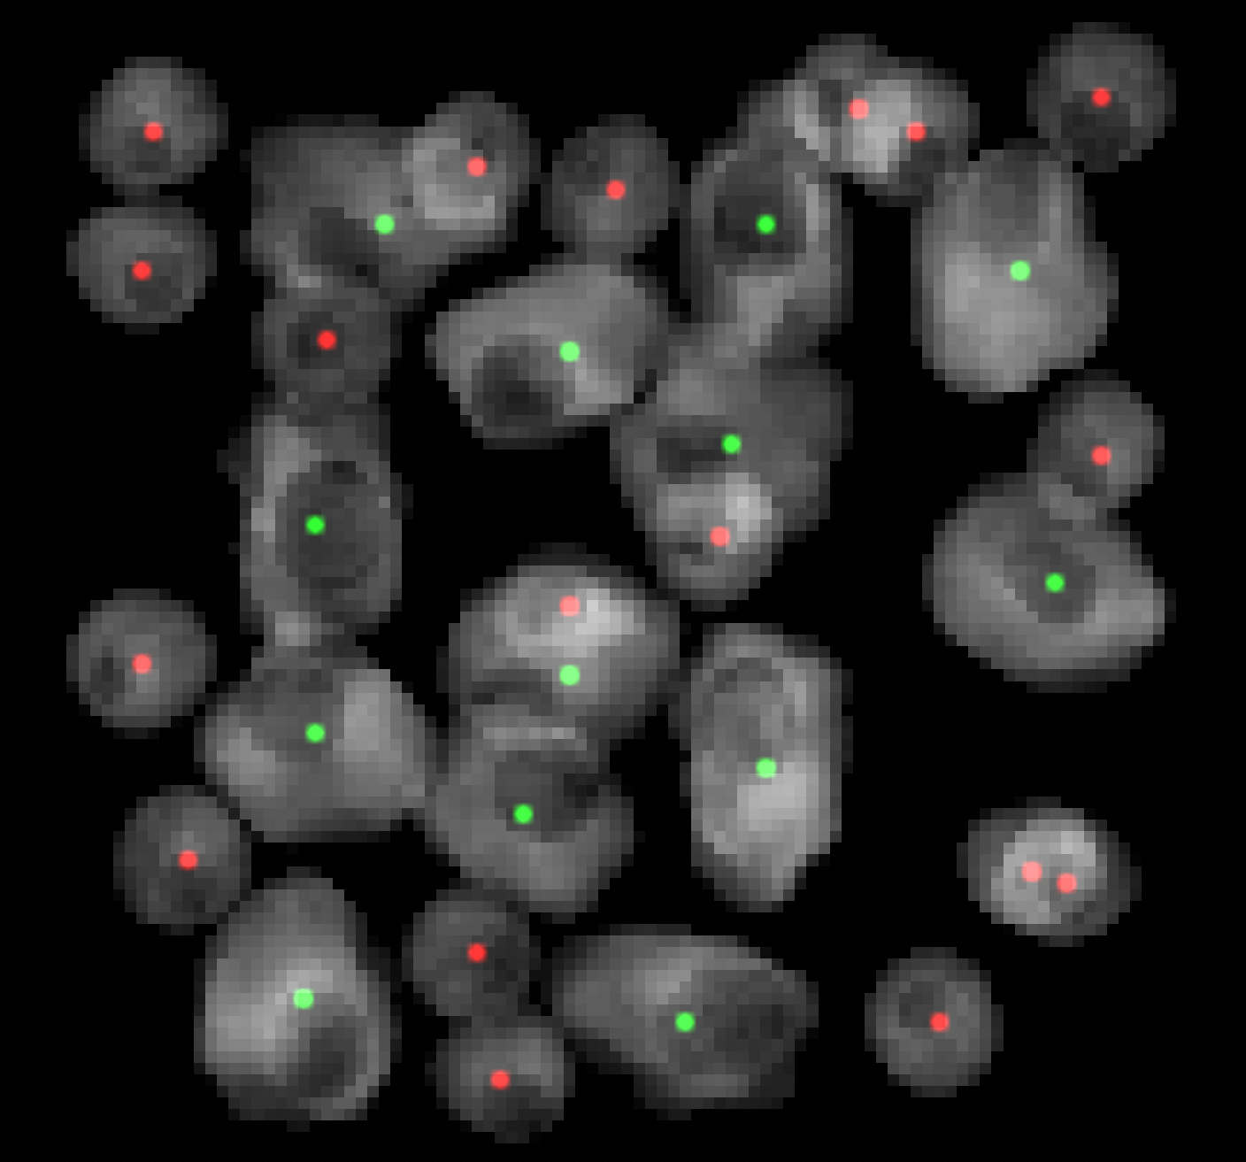
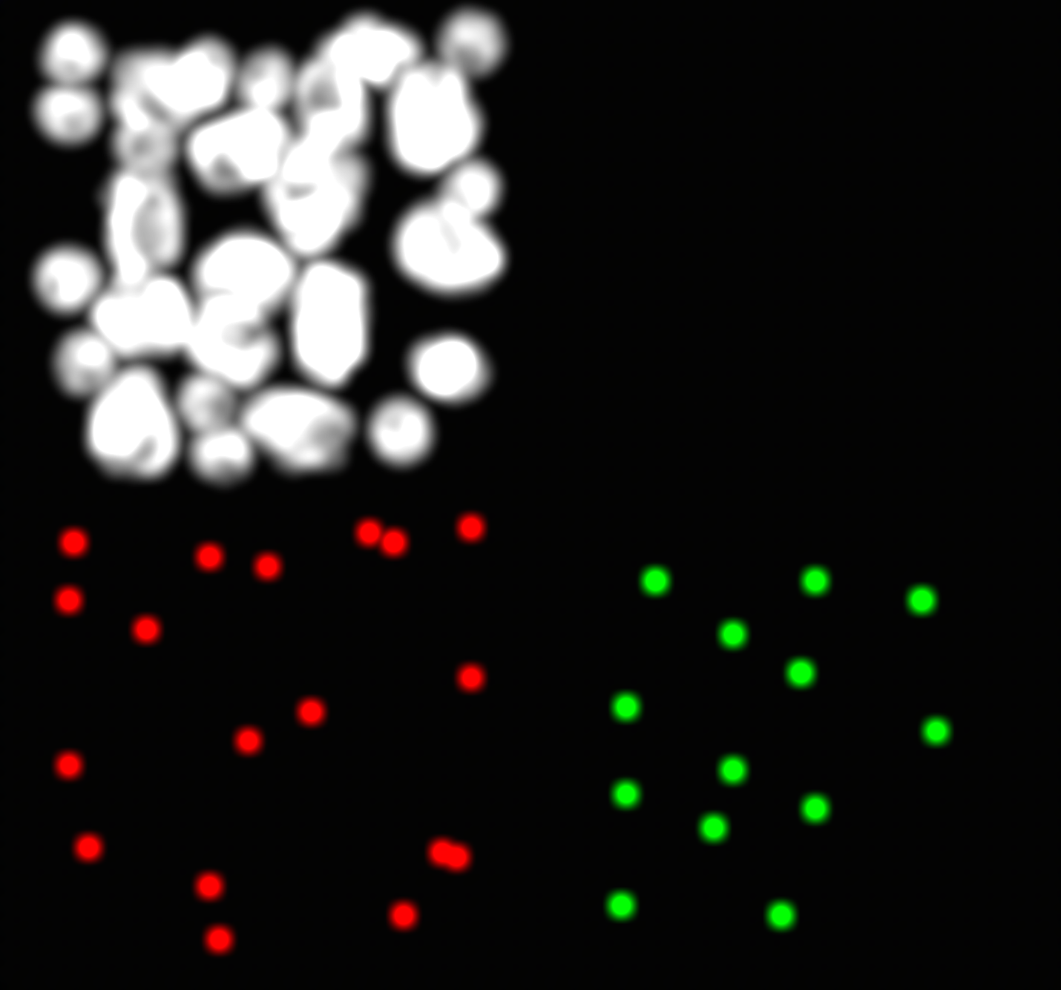
Neural Network
Exploitationi phase for Deep Learning approach
Aim: Network predicts each cell position for each class
 | Class | x | y | z
0 | Macrophage | 85 | 21 | 19
1 | Macrophage | 37 | 58 | 30
2 | Macrophage | 22 | 83 | 20
3 | Macrophage | 65 | 61 | 17
4 | Macrophage | 44 | 22 | 16
5 | Macrophage | 18 | 61 | 12
6 | Macrophage | 87 | 54 | 23
7 | Macrophage | 57 | 44 | 11
8 | Macrophage | 62 | 22 | 13
9 | Macrophage | 49 | 86 | 13
10 | Macrophage | 29 | 44 | 15
11 | Macrophage | 69 | 40 | 27
12 | Macrophage | 18 | 28 | 10
13 | T_Cell | 28 | 23 | 23
14 | T_Cell | 74 | 84 | 15
15 | T_Cell | 10 | 74 | 10
16 | T_Cell | 38 | 90 | 31
17 | T_Cell | 15 | 48 | 18
18 | T_Cell | 92 | 38 | 12
19 | T_Cell | 45 | 57 | 16
Conventional threshold method for cell quantification
MBT-net
1.Input stack
2.Neural Network
3.Output Probability density function (PDF)
4.PDF for each class
5.Postprocessing
6.Results of cell coordinates

Slide 21
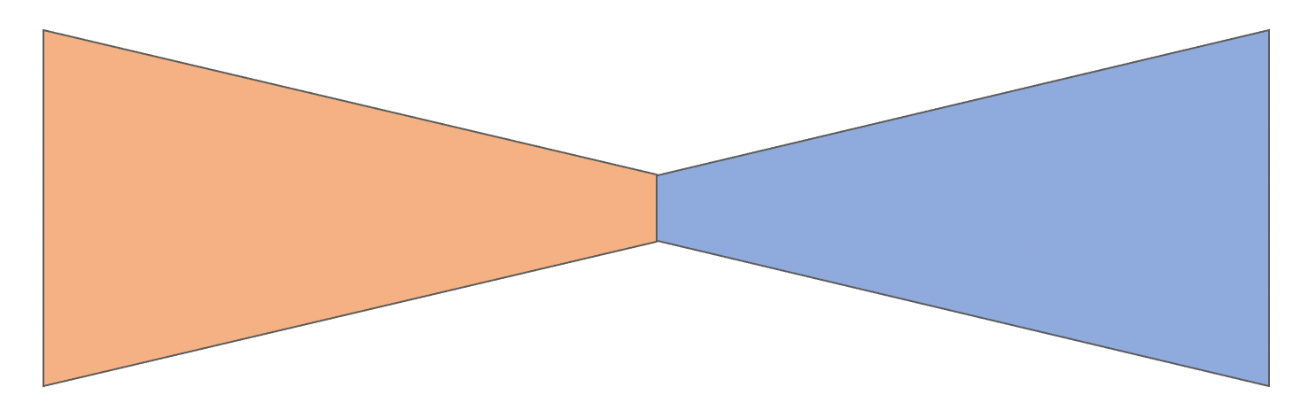

Neural Network
Architecture of MBT-net
Encoder
Decoder
+
+
+
Softmax
T-Cell
Macrophage
Background
18 x 128 x 128 x 28
36 x 66 x 66 x 16
18 x 128 x 128 x 28
9 x 252 x 252 x 52
MBT-net
9 x 252 x 252 x 52
1 x 500 x 500 x 100
3 x 500 x 500 x 100
Encoder block
Decoder block
BatchNorm
Conv3D
LeakyReLU
Conv3D
LeakyReLU
MaxPool
Interpolation
BatchNorm
Conv3D
LeakyReLU
Conv3D
LeakyReLU
Output
Compress data
Extract features
Reconstruct data
Extract features

Slide 22
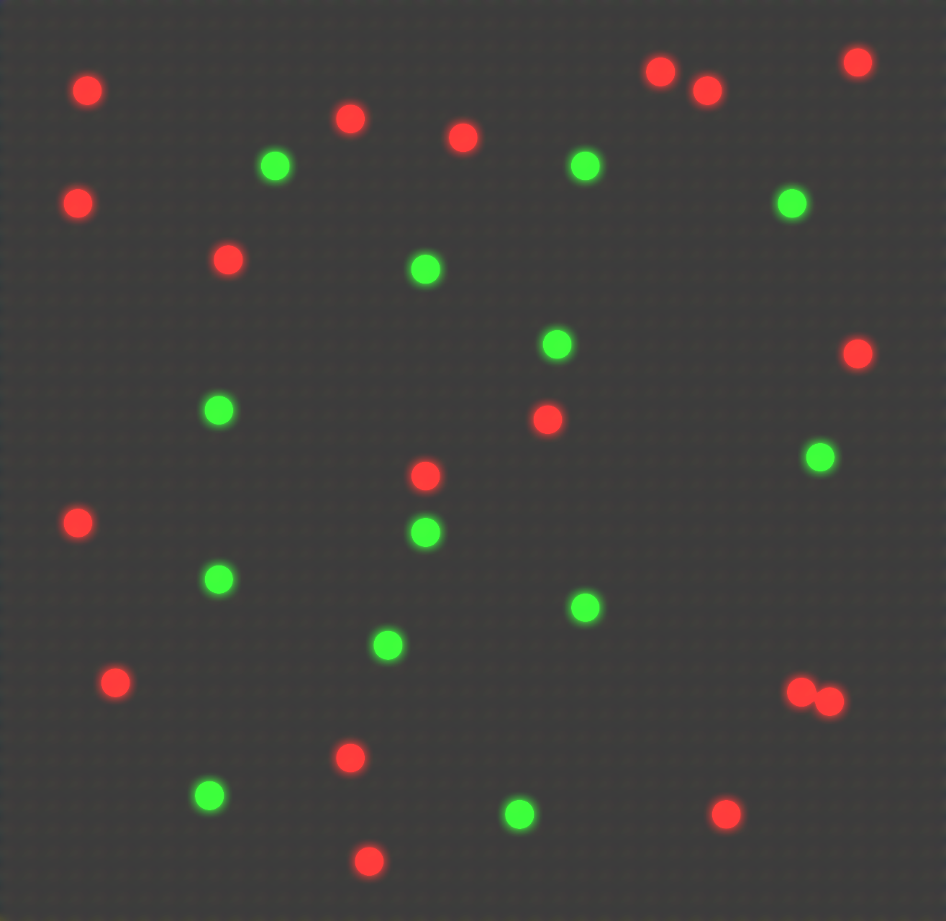
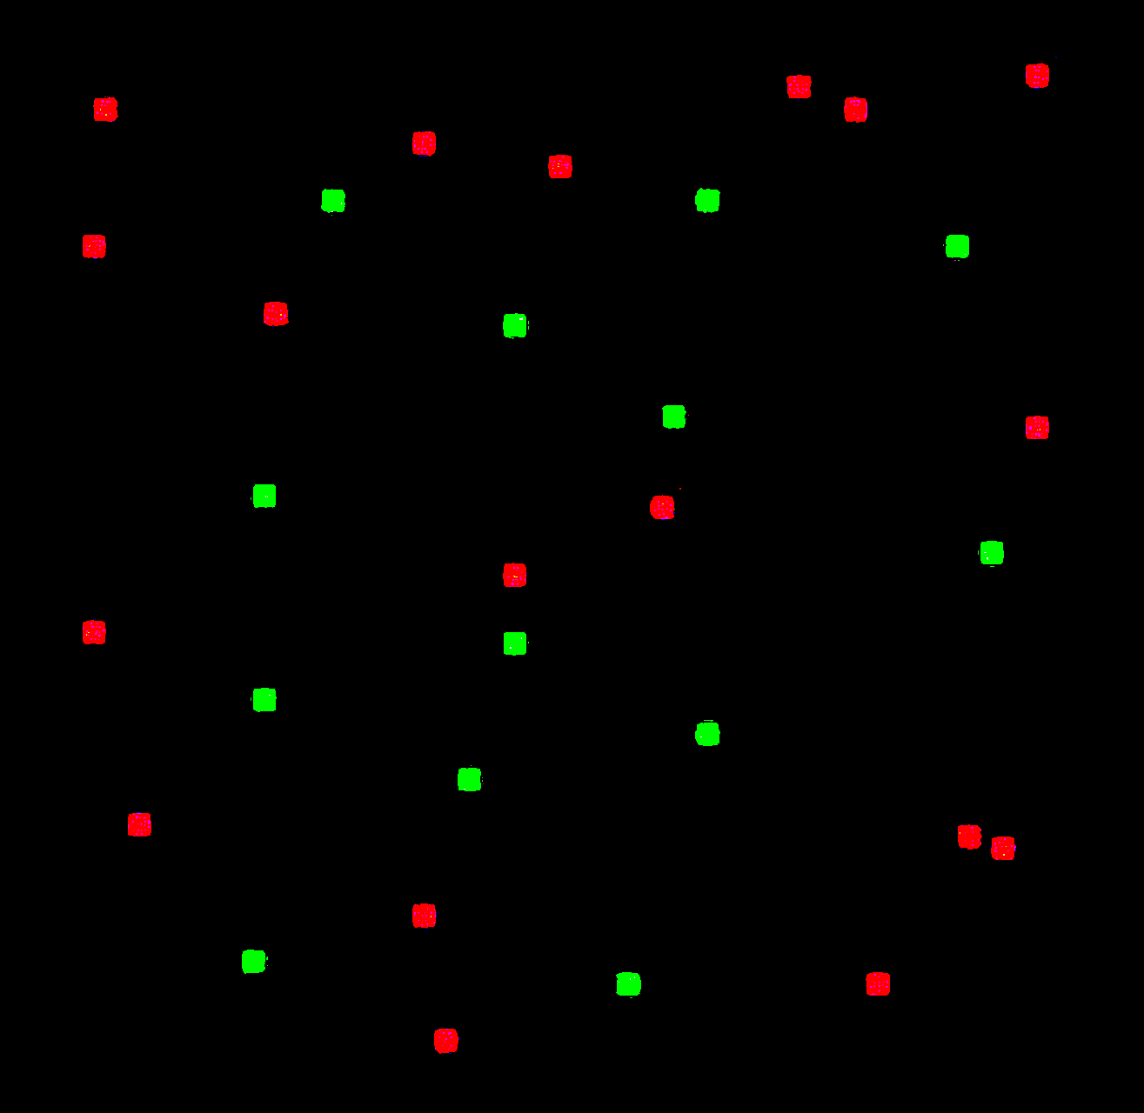
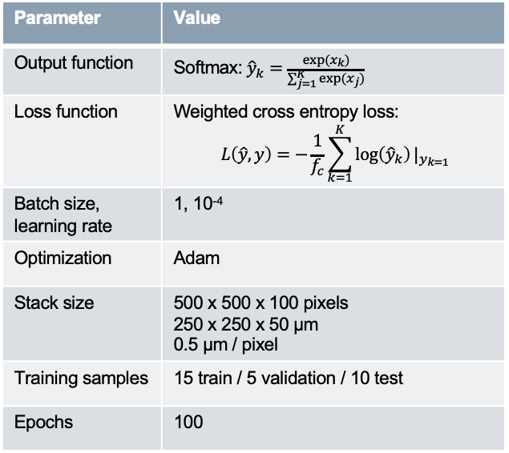
Neural Network
Training phase of MBT-net
Aim of training: minimize difference between network output and ground truth
Ground truth
Table 3: MBT-net training parameters
Data sample
Output
Parameter | Value
Output function | Softmax:${\hat{y}}_{k}=\frac{exp(x_{k})}{\sum_{j=1}^{K}{exp(x_{j})}}$
Loss function | Weighted cross entropy loss: $$L\left(\hat{y},y\right)=−\frac{1}{f_{c}}\sum_{k=1}^{K}{\log\left({\hat{y}}_{k}\right)}|_{y_{k=1}}$$
Batch size, learning rate | 1, 10⁻⁴
Optimization | Adam
Stack size | 500 x 500 x 100 pixels 250 x 250 x 50 µm 0.5 µm / pixel
Training samples | 15 train / 5 validation / 10 test
Epochs | 100
-
MBT-net
Loss
Cell Simulator

Slide 23
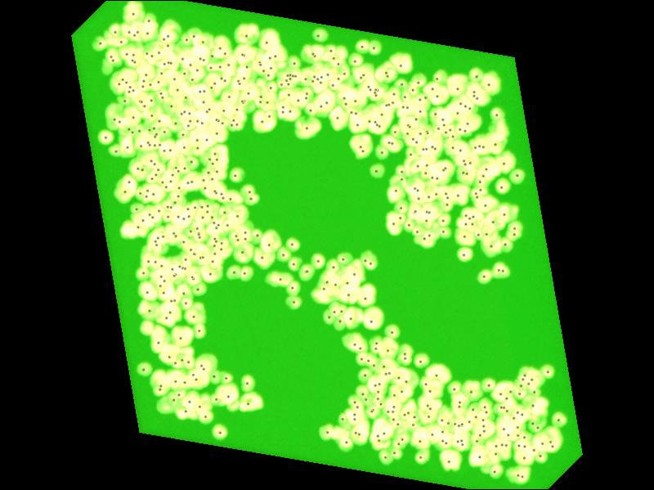
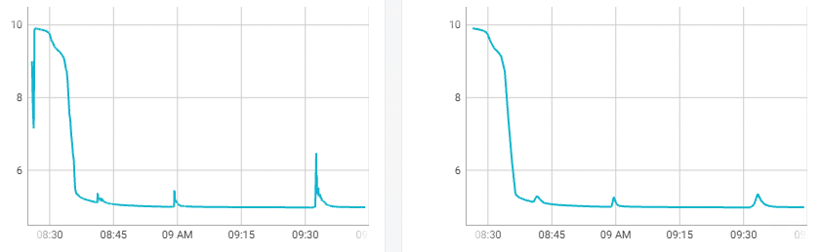
Neural Network
Training demonstration
Train loss
Validation loss
Video demonstrates MBT-net performance during trainging phase. With more training steps network’s output looks more localized

Slide 24
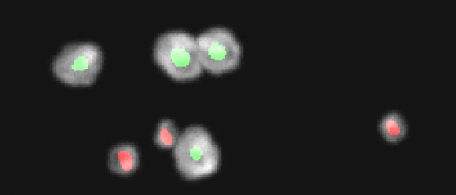
Neural Network
Visualization of output

Slide 25
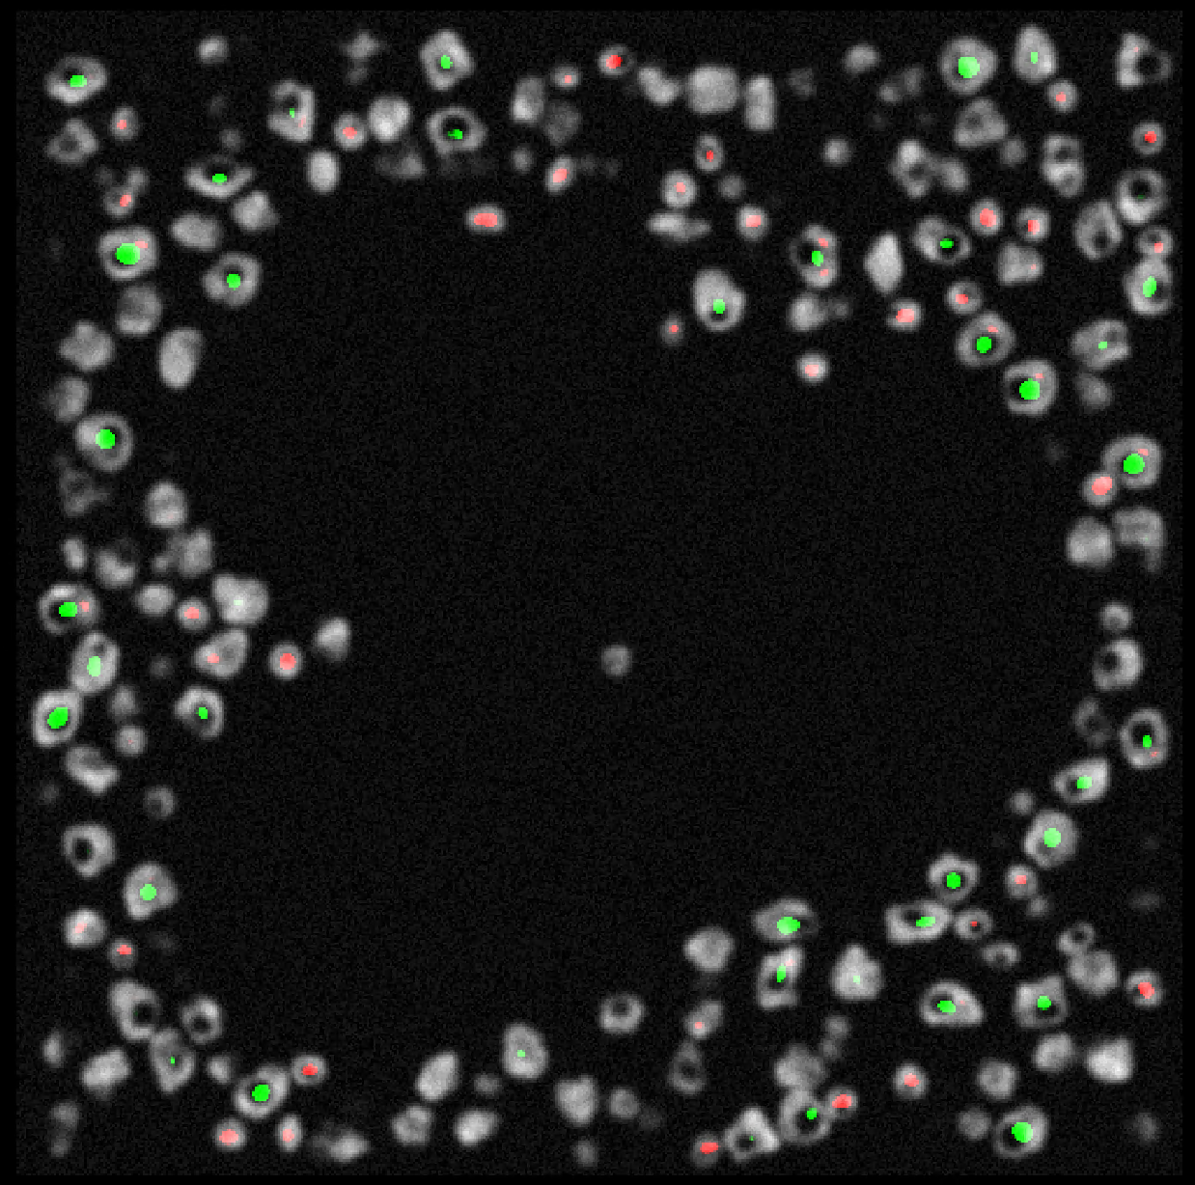
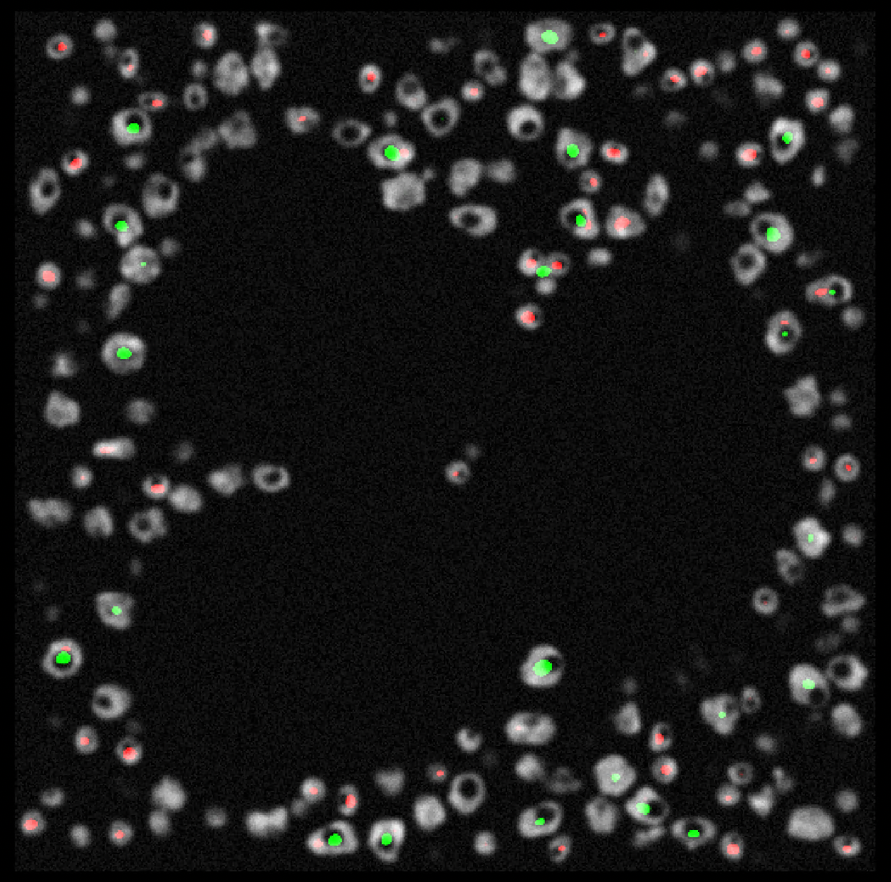
Neural Network
Visualization of output
Example of good cell localization
Example of error prone localization

Slide 26
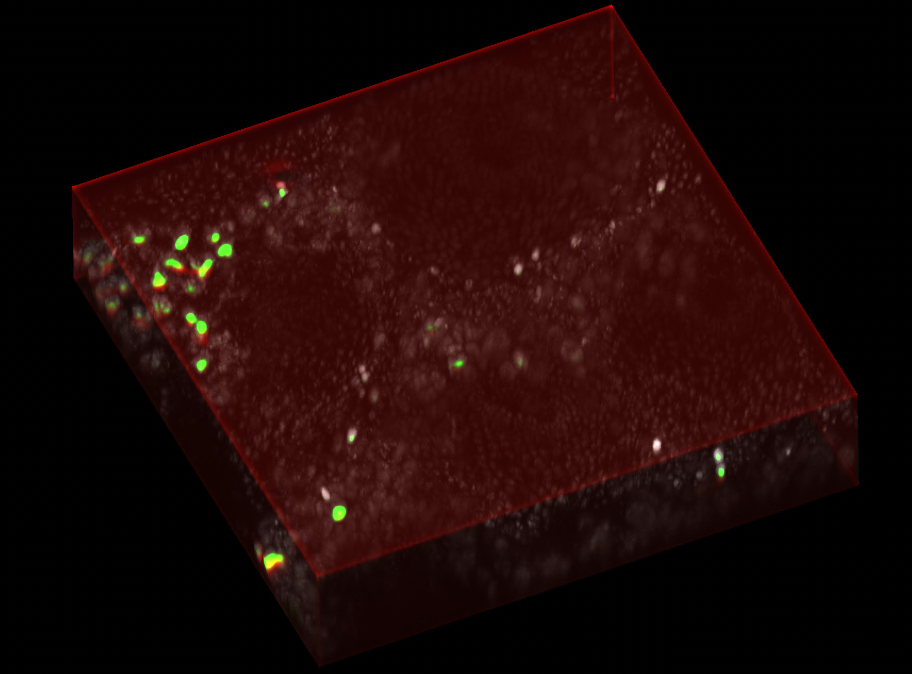
Neural Network
MBT-net view on real data

Slide 27
Results: Quantification performance

Slide 28
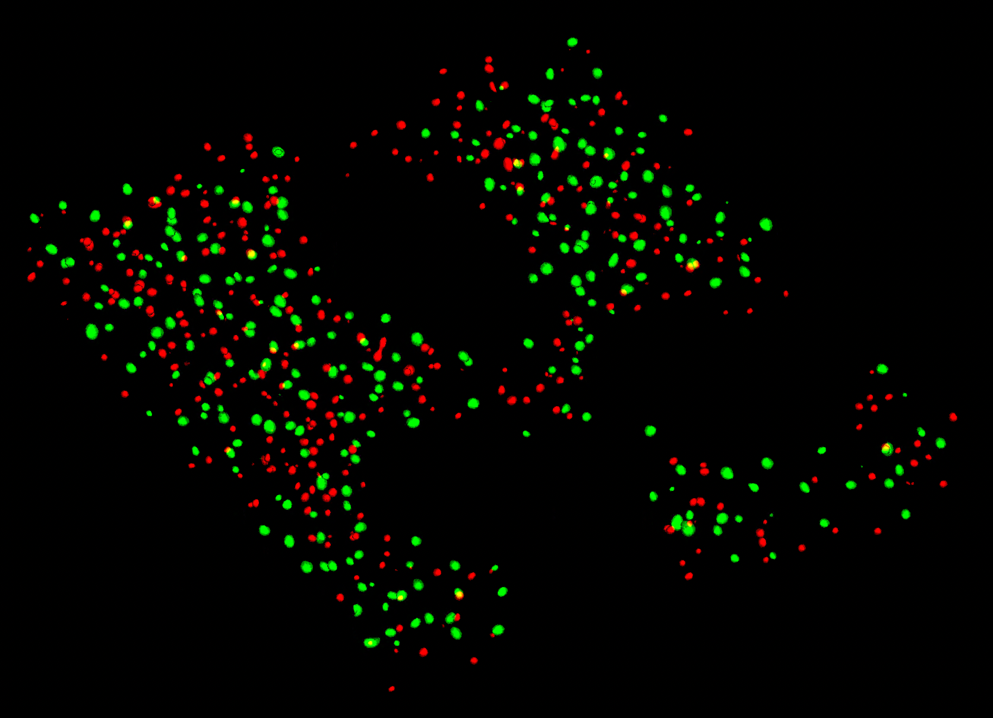
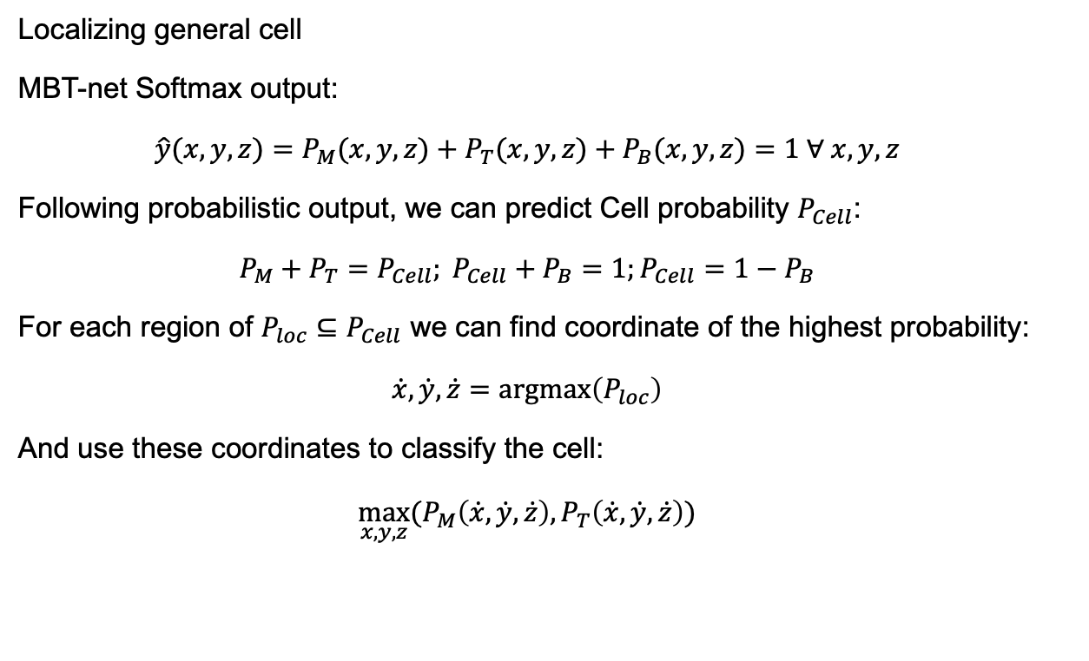
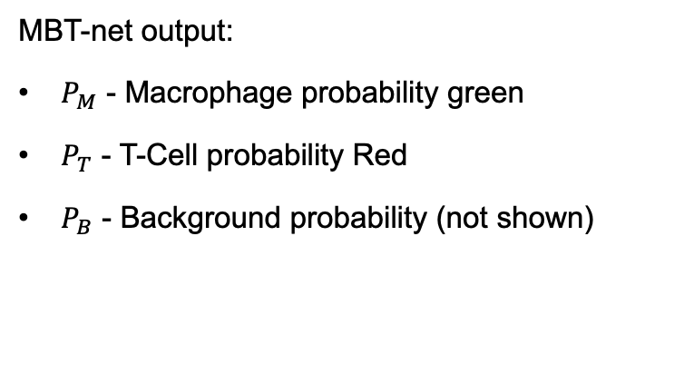
Quantification of cells
Cell quantification based on MBT-net output
MBT-net output:
$P_{M}$ - Macrophage probability green
$P_{T}$ - T-Cell probability Red
$P_{B}$ - Background probability (not shown)
Localizing general cell
MBT-net Softmax output:
$$\hat{y}(x,y,z)=P_{M}(x,y,z)+P_{T}(x,y,z)+P_{B}(x,y,z)=1 ∀ x,y,z$$
Following probabilistic output, we can predict Cell probability $P_{Cell}$:
$$P_{M}+P_{T}=P_{Cell}; P_{Cell}+P_{B}=1;P_{Cell}=1−P_{B}$$
For each region of ${P_{loc}⊆P}_{Cell}$ we can find coordinate of the highest probability:
$$\dot{x},\dot{y},\dot{z}=argmax\left(P_{loc}\right)$$
And use these coordinates to classify the cell:
$$\max_{x,y,z}{(P_{M}\left(\dot{x},\dot{y},\dot{z}\right),P_{T}\left(\dot{x},\dot{y},\dot{z}\right))}$$

Slide 29
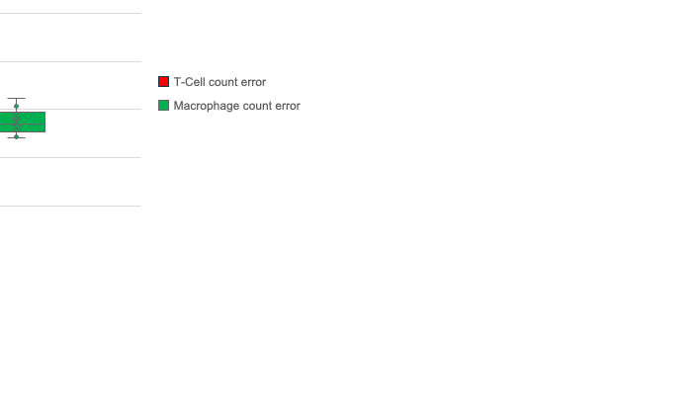
Quantification of cells
MBT-net performance
Table 4: MBT-net cell counting performance on test data
Stack # | Ground truth |  | Prediction |  | Misclassified %
 | Macrophage | T-Cell | Macrophage | T-Cell | Macrophage | T-Cell
0 | 336 | 364 | 312 | 366 | 7% | 1%
1 | 314 | 301 | 287 | 298 | 9% | 1%
2 | 285 | 313 | 262 | 317 | 8% | 1%
3 | 327 | 347 | 293 | 373 | 10% | 7%
4 | 329 | 353 | 299 | 364 | 9% | 3%
5 | 325 | 302 | 294 | 318 | 10% | 5%
6 | 340 | 308 | 302 | 325 | 11% | 6%
7 | 237 | 237 | 217 | 245 | 8% | 3%
8 | 324 | 308 | 301 | 317 | 7% | 3%
9 | 303 | 329 | 279 | 347 | 8% | 5%
 |  |  |  | Deviation | 1% | 2%
 |  |  |  | Average | 9% | 4%

Slide 30
Conclusion

Slide 31
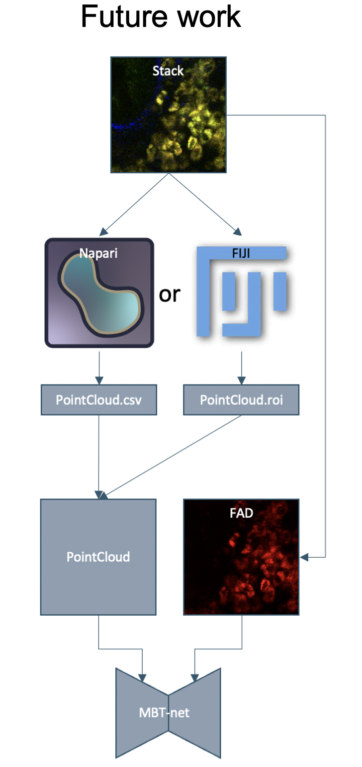
Conclusions and future work
Conclusions:
01
Simulator for creating 3D data-sets for training of neural network is developed
02
Neural Network for quantification of immune cells in volumetric images is developed
03
After training on synthetic data 90% counting/classification accuracy is guaranteed
Future work:
01
Training on real data
02
Imporvements of MBT-net

Slide 32
Thank you for your attention!

Slide 33
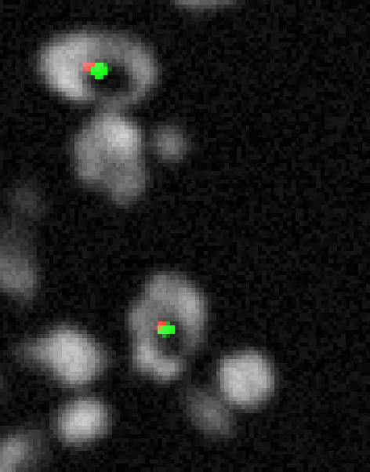
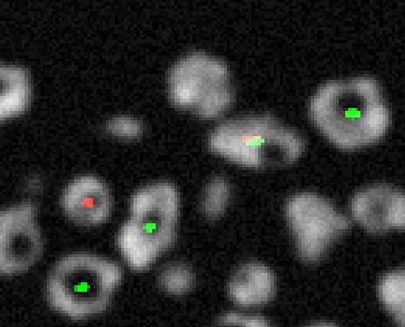
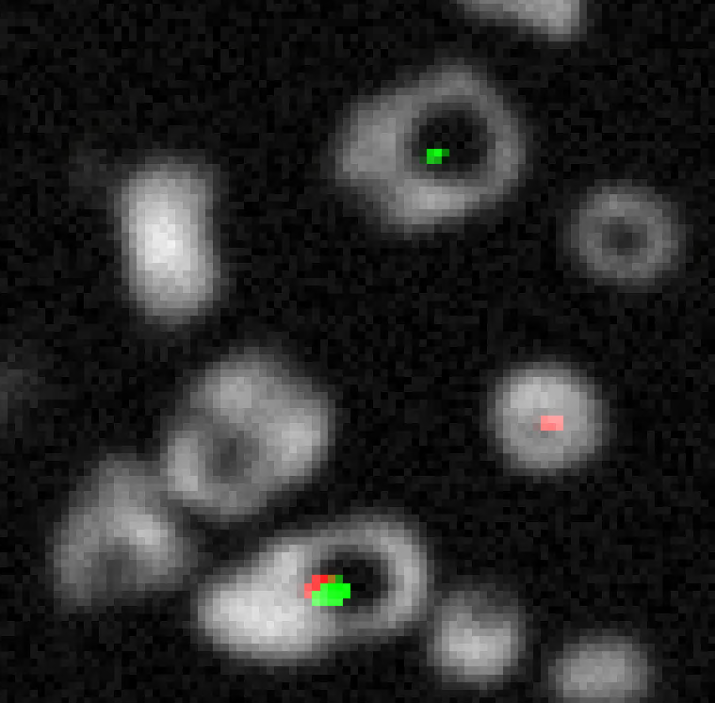
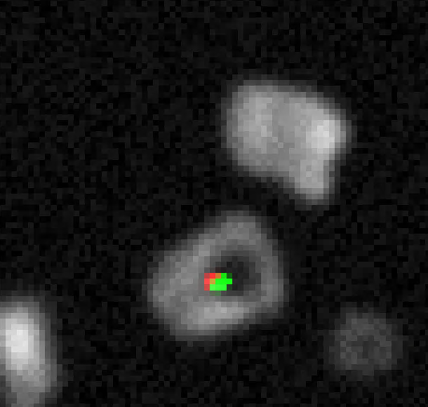
Supplementary slide

